Slide 1
5 element theory
An integrated approach to yoga
Aim of workshop
To provide an introduction and exploration of 5-element theory and its potential application in yoga practice

Slide 2
3 key questions
What is 5-element theory?
What is yoga practice?
How can the first be useful to the second?

Slide 3
What is yoga practice?
Concentration
Curiosity
Kleshas
Notes:
Asana, pranayama, meditation, shatkarma, holding one arm in the air, washing the dishes, walking to the front gate?
Can anything be yoga practice and if so – how?
Concentration, curiosity, kleshas ? - we can return to this theme in the Q&A if people are interested….
But most of us start with asana so that’s where we’ll start in terms of exploring the usefulness of 5 element theory.
However, we’ll return to the question of whether the same theory might be helpful in all manifestations of yoga practice.

Slide 4
Roots of 5-element therory
Yoga
Ayurveda
Samkhya / Tantra / Tibetan Buddhism
Notes:
5 element theory has roots that weave through Yoga, Ayurveda, Samkhya and Tantra - all of which contain overlapping but distinct approaches to skillful living
It is an experiential philosophy ie we can get a felt sense of it and it comes from people expressing what they feel.
The basis is pure consciousness exists without form but form arises from it in the shape of 5 ingredients that interact to create all of existence.
Hence the 5-elements are the basis of all matter whether we consider that matter to be alive or not, physical or mental.

Slide 5
The 5 elements
Ether / space
Air
Fire
Earth
Water
Notes:
Basic theory is the 5 elements are the ingredients of everything
The balance of the five varies and creates the infinite variety of experience.
Remember – you can’t buy a kilo of ether or earth you can only experience their influence in the world

Slide 6
Ayurvedic application
5 elements – base constituents
3 gunas – sattva, rajas, tamas – attributes reflecting the balance of the elements
3 doshas – vata, pitta, kapha - human tendencies in relation to the elements
Notes:
Use an example to illustrate –
I am pitta dosha – my tendency is toward excess fire
Ayurveda describes this tendency as a susceptibility to rajas imbalance
Sattva – 5 elements in harmony
Rajas – predominance of fire and air
Tamas – predominance of water and earth
But I am all 5 elements and can on occasion be sattvic ie balanced, or tamasic. Pitta just means that if I do become out of balance I am more commonly rajasic.
In my case this manifests as overdoing it then collapsing, or just being restless. But it also means I am generally self-motivated and energetic.
Dosha assessment – read thru list P34-35 -

Slide 7
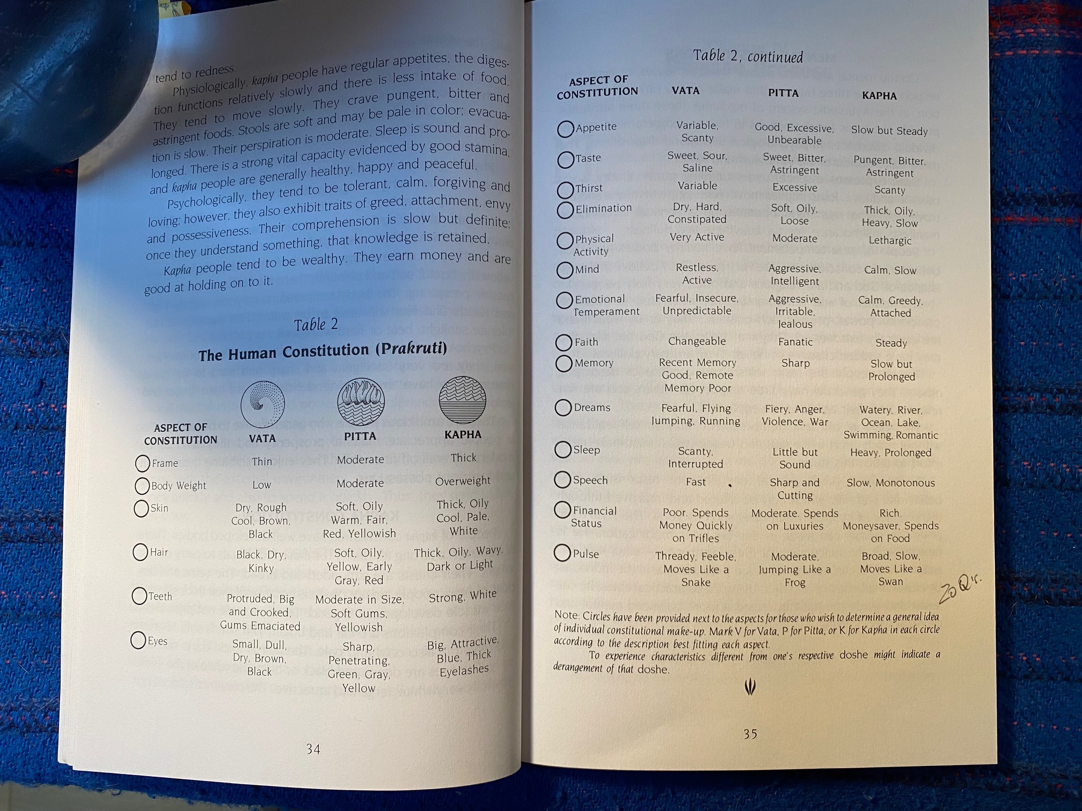
Notes:
Next slide has table linking dosha type to 5 elements

Slide 8
The 5-elements and the doshas
Dosha | Imbalance tendency | Harmony cultivation
Kapha | Earth | Air / fire
Vata | Air | Water / earth
Pitta | Fire | Water / earth / space
Notes:
Try to complete by 11.00 – short comfort break (15mins) then asana exploration of the elements individually…..

Slide 9
Break

Slide 10
Asana exploration of the individual elements
Ether / space
Air
Fire
Earth
Water

Slide 11
Links to psycho-emotional states
 | Excess | Harmony | Deficiency
Earth | Stuckness, Dullness, depression, lethargy | Compassion, concentration, groundedness | Indecision, confusion, dissociation, doubt
Water | Scattered, sloppy | Intuitive, curious, flexible, flowing emotions | Close minded, obsessive, controlling
Fire | Agitation, anger, anxiety, grasping | Strong willed, energetic, enthusiastic, logical | Lethargic, indifferent, disconnected, self-pitying
Air | Dreamy, distracted | Light heartedness, funny, joyful | Fearful, introspective, listless
Space | Dissociated, dissipated | Clarity, inclusivity, equanimity | Confusion, fear, helplessness
Notes:
These are my words – don’t take them as gospel – consider for yourself.
Q&A if time available – lunch break at 1pm

Slide 12
lunch

Slide 13
The 5 elements in harmony
What does ‘harmony’ look / feel like?
Physical – foundation, coordination, ease
Emotional – fluidity and equanimity
Psychological – curiosity, right concentration, right awareness
No destination - as harmony is constantly a shifting goal. Link to enlightened action rather than enlightened state.
Notes:
Harmony as right effort – steady comfortable (sthira sukha) asana
Harmony is a flexible ‘ideal state’ moment to moment
May also be useful to think of harmony as balance or DYNAMIC EQUILIBRIUM – it is not a single point destination but a scale – we can be more balanced and less….
So – applications in yoga practice……3 approaches….

Slide 14
Using 5 element theory in yoga
Teaching themes or specific groups
To relate to recurrent tendencies in students or ourselves
As an assessment and communication tool in the moment
Notes:
We’ve already begun to consider these territories but now we’ll look at them each in turn….

Slide 15
Teaching themes or specific groups
Third age groups – cultivating earth and water (balance and mobility)
Stress reduction - calming fire with earth and water
Seasonal rhythms – autumn / winter (earth & fire), spring and summer (settling air and water)
Serious illness – eg cancer groups – cultivating harmony with a particular emphasis on personal energy

Slide 16
Individual assessments
Dosha | Imbalance tendency | Harmony cultivation
Kapha | Earth | Air / fire
Vata | Air | Water / earth
Pitta | Fire | Water / earth / space
Notes:
This is the same table we saw earlier. But important to remember that everyone is a mix of all doshas and elements and that they vary day to day.
Cannot assume too much – this is a helpful guide rather than a definitive diagnostic tool or treatment
Also remember that disharmony may cross over the arbitrary body-mind boundary and it is sometimes hard to know whether the imbalance begins –
EG pain – fire – can generate ripple effects in physical and pycho-emotional terms
Mild fatigue may be alleviated to some degree with air and fire, depression likely to be much less responsive (even though physically they may look similar).
If dosha patterns are entrenched an individual may have no sense of the balancing element so creativity sometimes required – eg shake hand to cultivate water rather than shake spine
Also remember that preference can masquerade as balance – eg we may want to feel energized and grounded and productive at all times. Think daily / seasonal / life stage variation….
End by 1430 latest

Slide 17
Use as an assessment & communication tool
Be kind…and remember you’ve all been working toward balance for years (it will be clearer in your students)….
Consider blocks (typically too much something)
Consider empty spots (too little)
Once you’ve found something - work together to imagine ways of communicating / explaining to a newish student changes that might bring them closer to harmony
Remember harmony does not mean an arbitrary standard of perfection eg Iyengar’s photo! – it means most balanced for you in that moment
Notes:
In sub groups….
Be kind…
Remember you’ve all been working toward balance for years (it will be clearer in your students)….
Consider blocks (typically too much something)
Consider empty spots (too little)
Once you’ve found something work together to imagine ways of communicating / explaining to a newish student changes that might bring them closer to harmony
Remember harmony may not mean an arbitrary standard of perfection eg Iyengar’s photo! – it means most balanced for you in that moment
Complete by 15.30 then plenary session, summing up and Questions.

Slide 18
5 element theory in yoga – summing up
5 element theory is a tool for identifying and working with imbalance
Emphasises sensation / intuition rather than analysis or mental constructs
Can be used at group / theme level or for individual assessment
Can be used no matter what our yoga intention or specific practice

